Slide 1



Rajendra Mane College of Engineering and Technology, Ambav, Devrukh.
Department of Computer Engineering
A Project Presentation on
Alien Invasion Game Using
Python
Prepared by:
1.Atharva Mukesh Birje
2.Vinay Ramesh Pawar
3.Rahul Avdhut Haryan
4.Koustubh Vijay Raorane
Under the guidance of:
Mrs.Kamble S.B.

Slide 2
Index
Introduction
Aim & Objectives
Literature Survey
Problem Statement
Project Design
Implementation
H/W & S/W requirements
Applications
Advantages
Disadvantages/ Limitations
Conclusion & Future Scope
References

Slide 3
Introduction
Alien Invasion is a 2D game in which the aim is to shoot down the fleet of alien as they drop down the screen in levels that increase in speed and difficulty.

Slide 4
Aim & Objectives
Aim:
To destroy the alien fleet from attacking the space ship.
Objectives:
1.To give enjoyable moment to a player
2.Stress reliever.

Slide 5
Literature Survey
Sr.No. | Paper title | Author Name(s) | Publication Details | Relevance to Proposed system
1. | Pygame alien invasion. | Eric Mattes | Alien Invasion project | Author has developed a game alien invasion .

Slide 6
Problem Statement
As of today’s game are more FPS based many people are not able to play it as they graphical requirements are top-notch. To solve this problem we create a basic free game which can be accessed by any peripheral device.

Slide 7
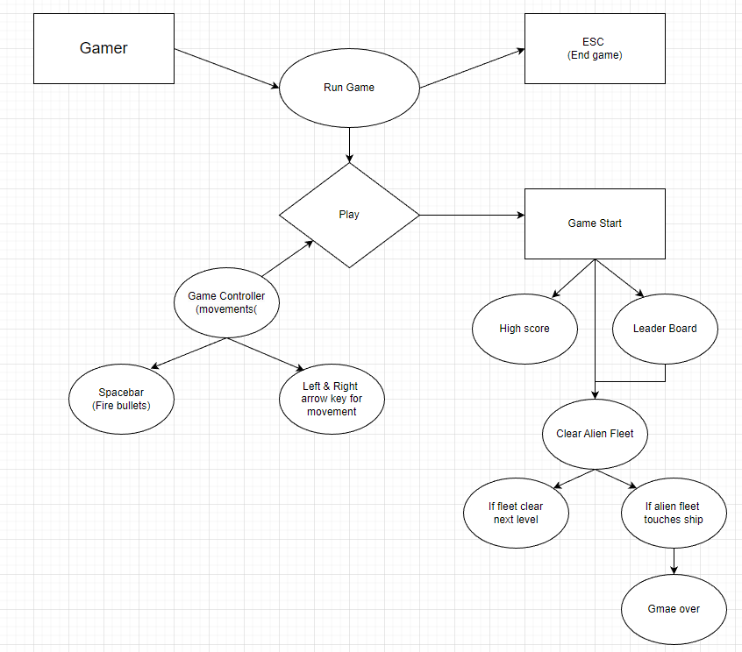
Project Design

Slide 8
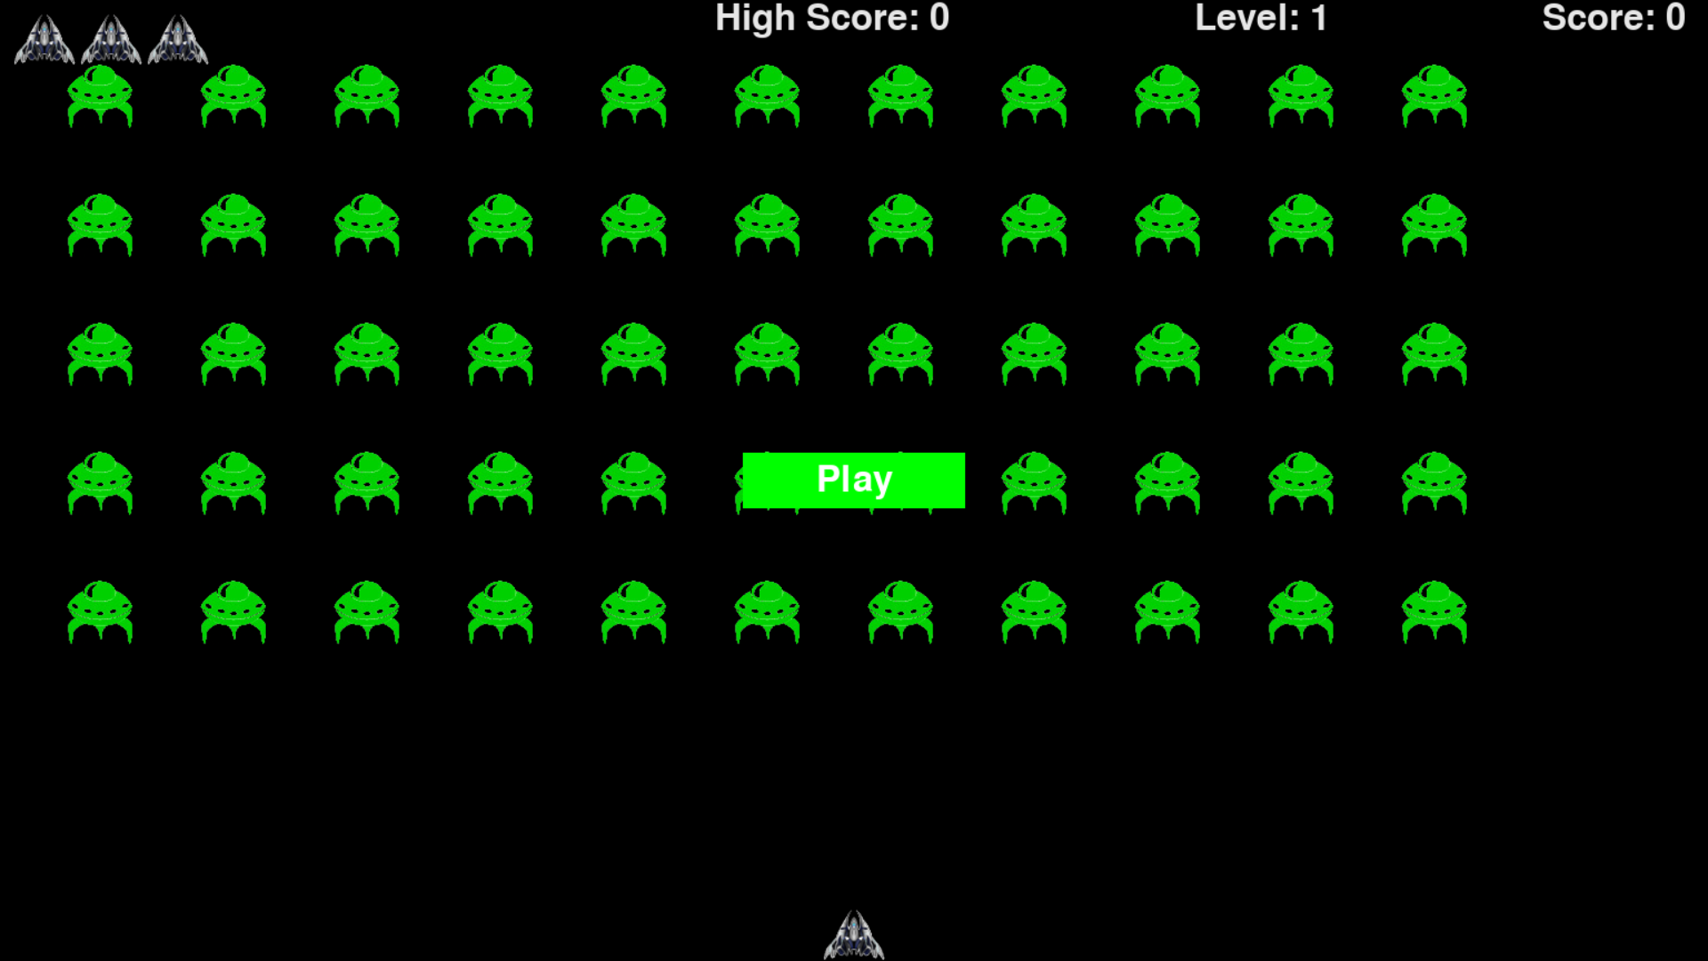
Implementation
Play Game

Slide 9
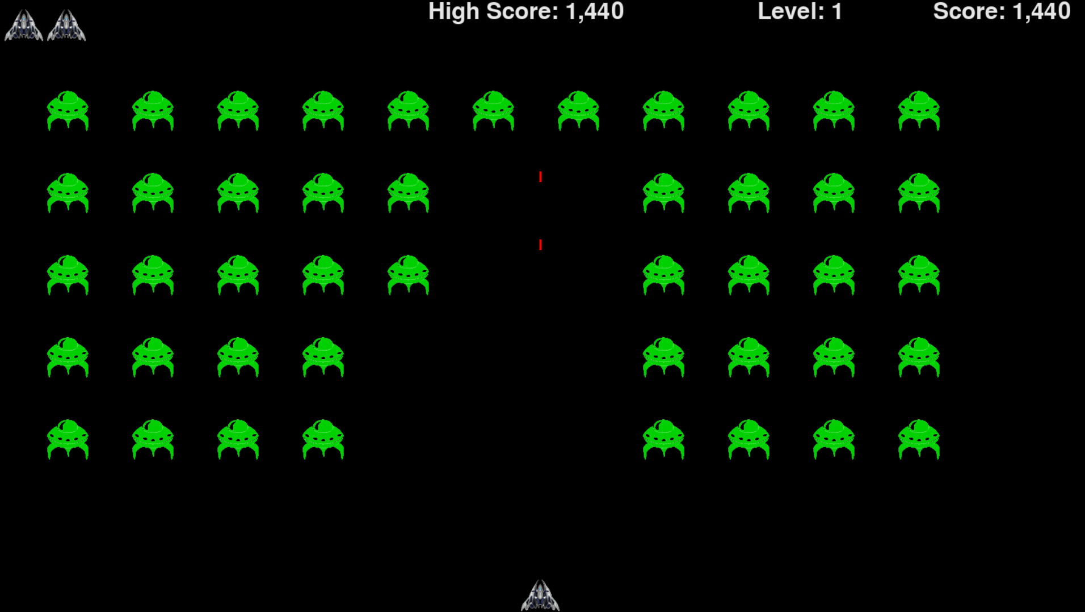
Implementation
Bullet Firing and changing Score

Slide 10
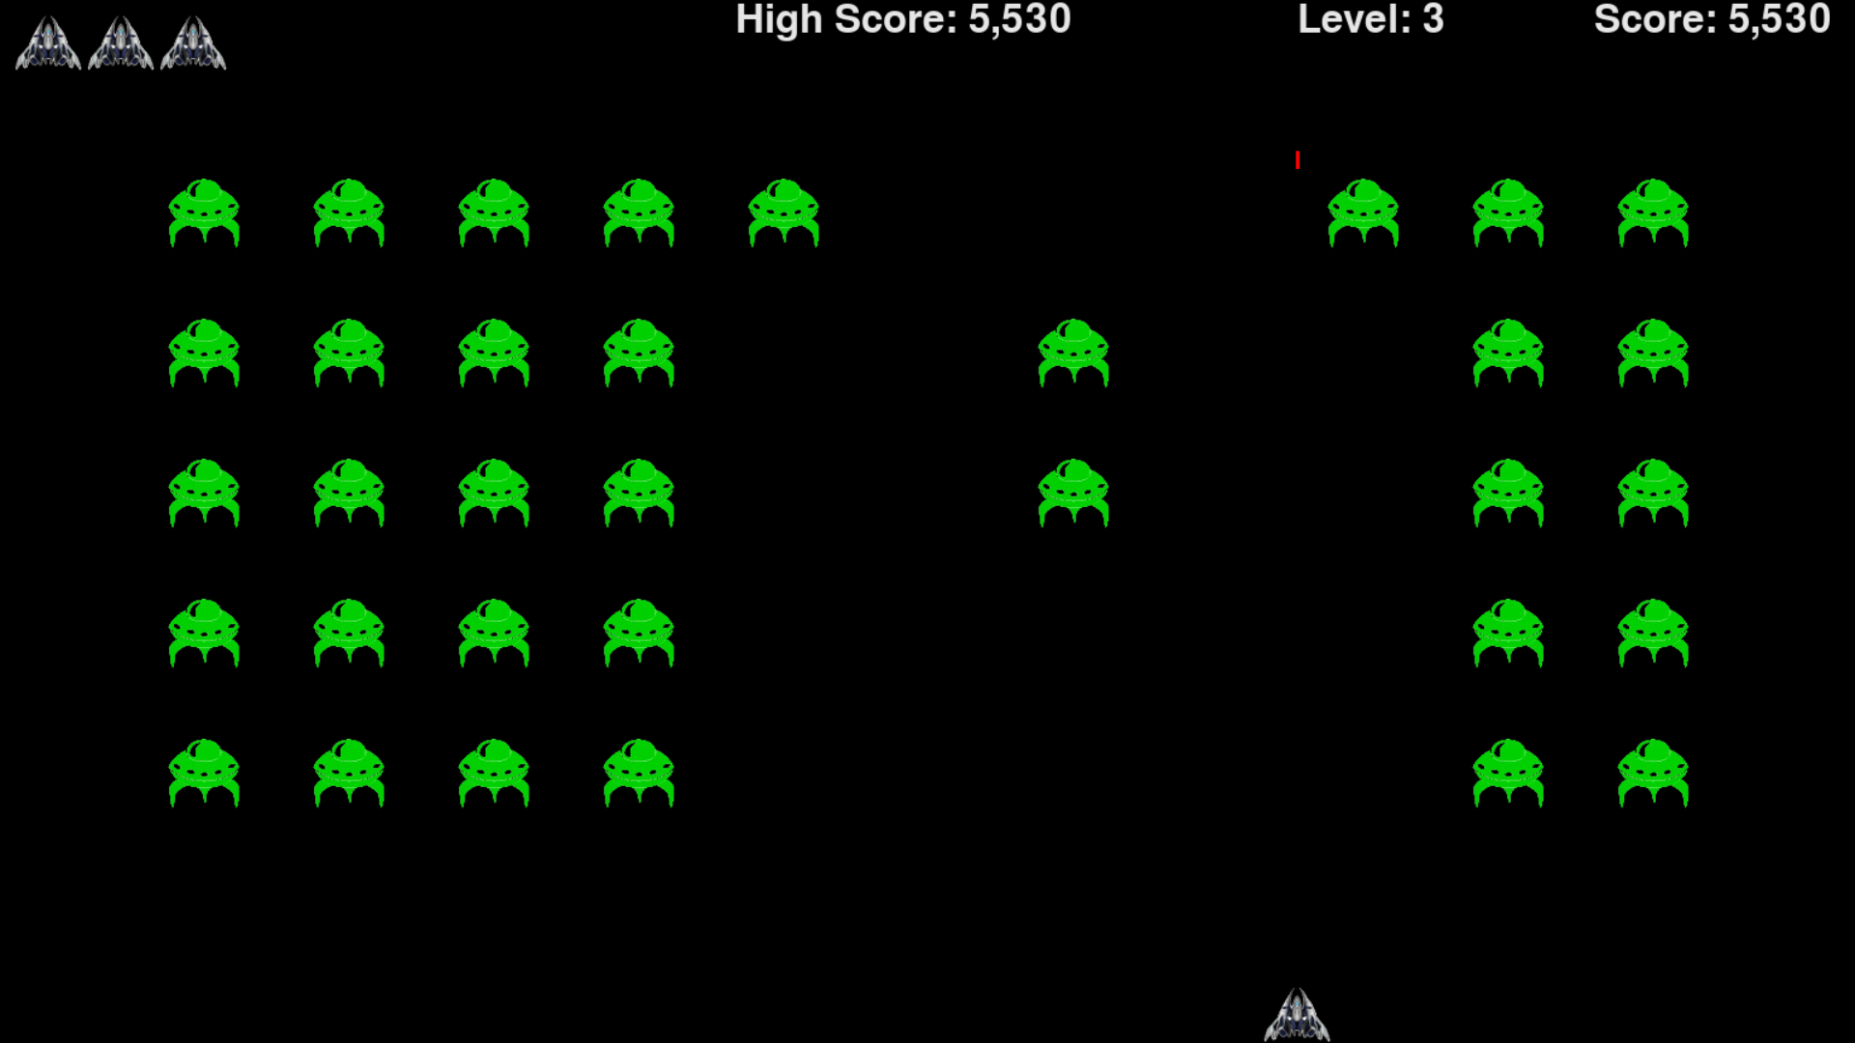
Implementation
After completing Fleet we enter next level

Slide 11
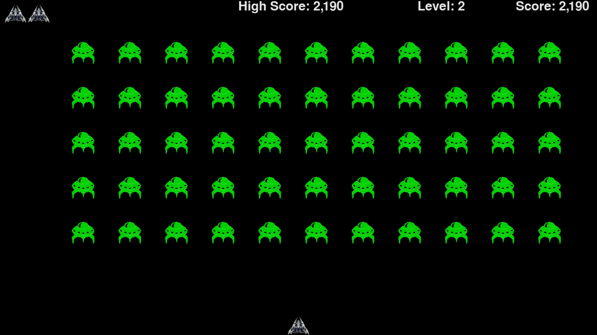
Implementation
when fleet touches ship game restarts, player loses 1 life

Slide 12
H/W & S/W Requirements
H/W requirements:
Processor-Intel Pentium 4 higher
HDD-Minimum 10GB
RAM-Minimum 4GB
S/W requirements:
Front End/Programming language-Python
OS-Windows 7 and higher
IDE-Visual Studio Code

Slide 13
Applications
Stress reliver
As an entertainment
For having Funtime with friends
Available for low end devices

Slide 14
Advantages
1.Time and cost efficient.
2.Free to play
3.User Friendly.

Slide 15
Disadvantages/ Limitations
1) Addictive for underage kids
2) Lack of focus and concentration

Slide 16
Conclusion
We want to create a game that has a very interesting mix of inputs. In order to ensure that the game is fun, we want the difficulty of the game to scale linearly with the length of time/ skill of the player.

Slide 17
References
Papers:
Pygame ALIEN INVASION by ERIC MATTHES
Links:
[1]https://nostarch.com/pythoncrashcourse2e

Slide 18
THANK YOU!

